Slide 1
Design Review
Emergency TA Availability
Ruiwen Li
Zheiqing Li
Stephen Chuang

Slide 2
Introduction
Lack a way for TAs and professor in charge communicate efficiently
Provide a list of available TAs

Slide 3
Requirements
Functional: login, schedule, database
Non-functional: security, reliability, performance
Constraints: web-based, Linux OS, Chrome, Firefox

Slide 4






Technology Used

Slide 5
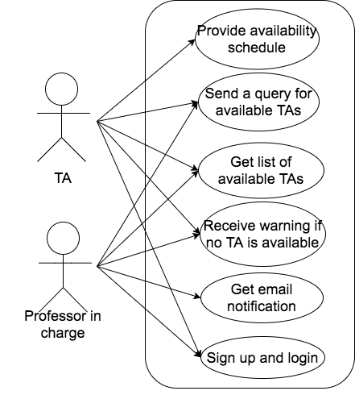
Use Case

Slide 6
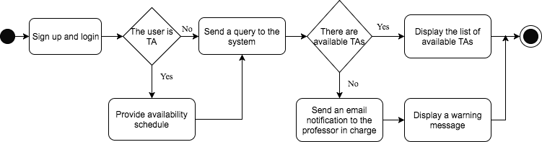
Activity Diagram

Slide 7
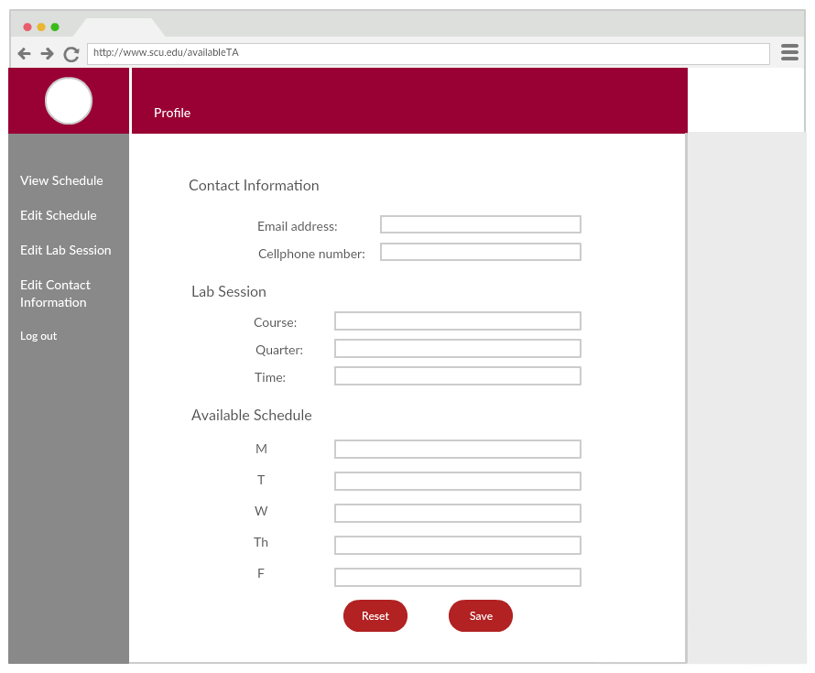
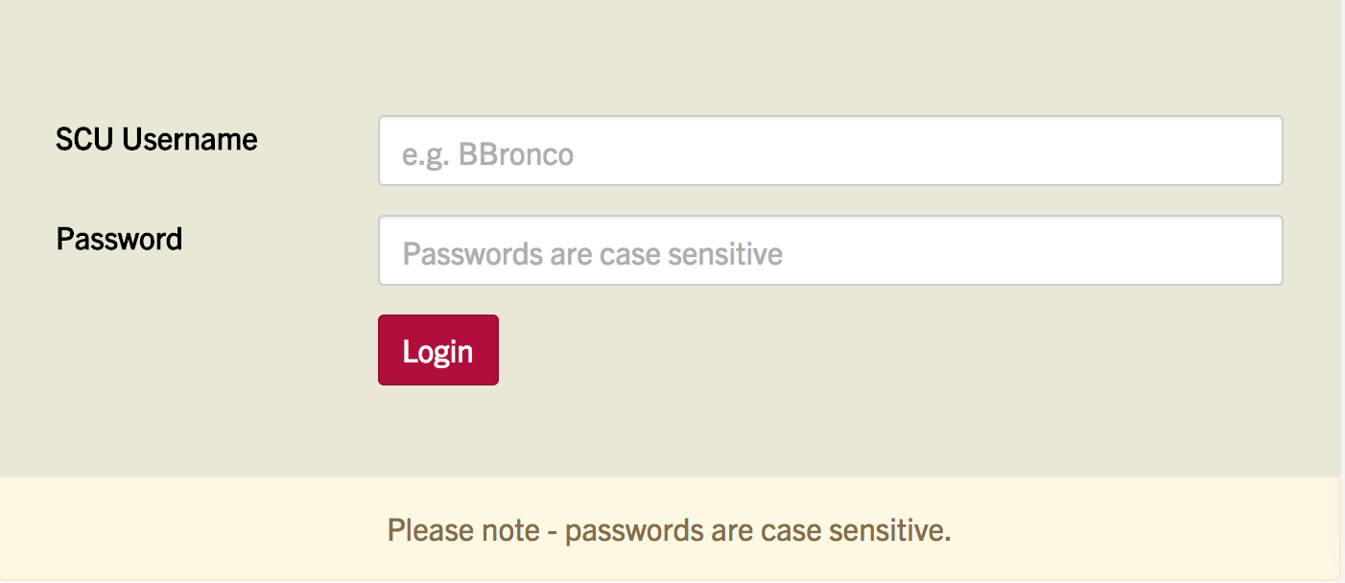
Conceptual Model

Slide 8
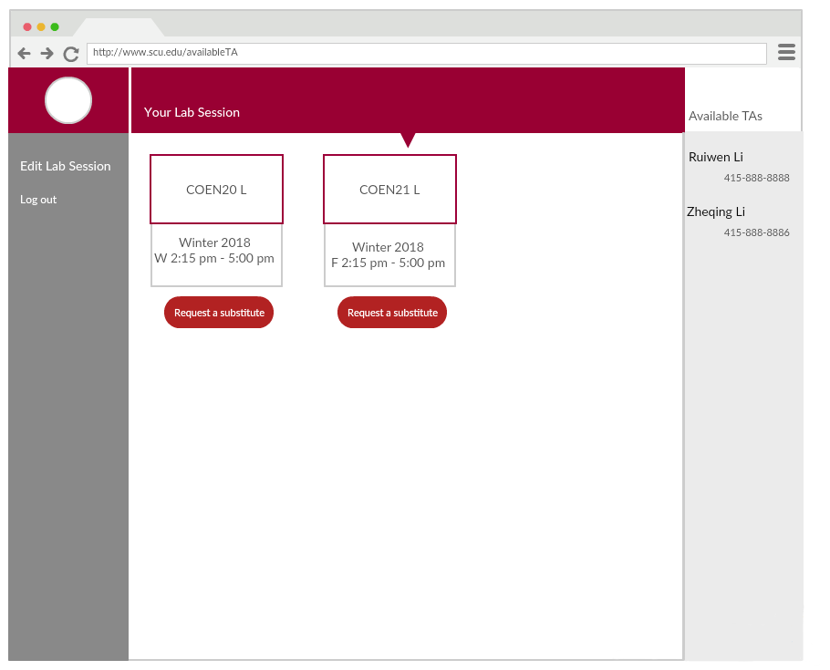
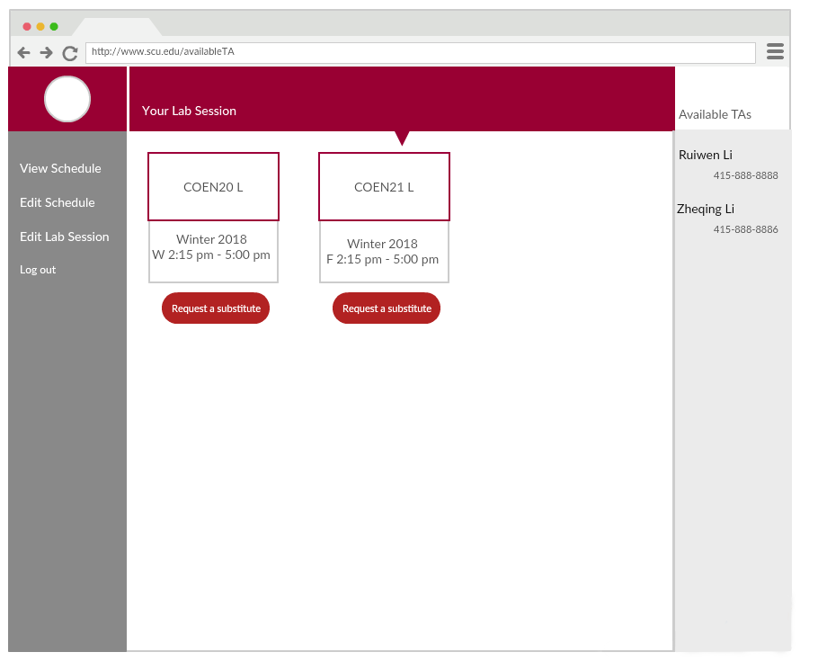
Conceptual Model

Slide 9
Risk Analysis
Risk | Consequences | Probability | Severity | Impact | Mitigation Strategies
Messages send to available TAs fails | User can not inform others | 0.3 | 10 | 3 | Implement the system with high response
Long response time in searching | User can not get available TAs’ list | 0.2 | 9 | 1.8 | Make easy database system, and operate fast
Failed to inform the professor when no available TA is found | There will be no TA in the lab | 0.1 | 10 | 1 | Have an acknowledgement to tell if the professor has been informed
Long response time in sending messages | The communication process will be long | 0.4 | 2 | 0.8 | Implement easy and simple system which sends messages quickly

Slide 10
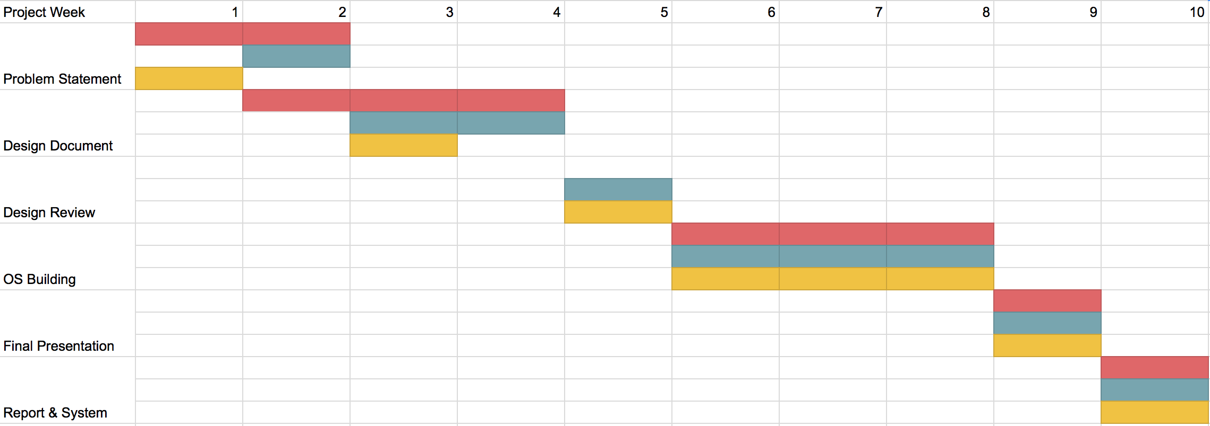
Development Timeline
Louise
Zheqing
Stephen

Slide 11
Questions?

Slide 12
Thank you!

